Slide 1
SoI — Prototype Stage
Submission Deck Template
Team Details
Team: TechNova Squad
Team-ID: P-2023-27-EI-015
Lead: SHANKAR D
Members: RATHIKA S , SHYAMJITH K , TANUSHRI Y
Mentor: SRIRAM R
Lab Code: EI
Cohort: 2023-2027
Date: 27/01/2026
File name:SoI_Prototype_TechNova Squad_EI_15.pptx

Slide 2
SoI Innovation Pipeline
CONTEXT
Problem & End-User Recap
Problem statement :
This project aims to develop a smart IoT-based safety device that can automatically detect vehicle accidents and send instant alerts. It uses sensors like accelerometers, gyroscopes, and impact detectors to identify collisions of any severity. Once an accident is detected, the system collects the vehicle’s GPS location and sends real-time accident details to emergency services and the driver’s emergency contacts through GSM. This helps in getting quick medical help and improves the chances of saving lives.
Target end-user / context:
Car owners and fleet operators who want automatic accident alerts, along with ambulance services and family members who receive real-time notifications.
Evidence:
WHO and MoRTH data show nearly 50% of accident deaths can be prevented with timely help; families and drivers report delays in ambulance arrival and lack of immediate notifications.
Success metric(s):
Instant alert delivery, accurate location sharing, reduced response time.

Slide 3
.
.
SoI Innovation Pipeline
IDEATION
Ideas explored
Idea 1 - Airbag-Triggered IoT Accident Alert System
Idea 2- Sensor Triggered IoT Accident Alert System
Idea 3- Seatbelt-Integrated Vital Monitoring Module
Sensor-Triggered IoT Accident Alert System that automatically detects crashes and sends real-time emergency contact notifications with GPS location.
Selected idea (taken to PoC)
Why selected (Design Thinking lenses)
It is highly desirable for road safety, feasible with available IoT sensors, and viable as a low-cost, scalable solution for all vehicles.
Multi-Sensor Impact Detection: Simulate crash using on-board sensors (e.g., accelerometer for G-force).
Location Retrieval & GSM Alert: Fetch simulated GPS coordinates and transmit basic alert.
Basic System Initialization: Start and run simulation loop for event monitoring.
MoSCoW: Must-have features for PoC

Slide 4
SoI Innovation Pipeline
POC
PoC Recap — What We Built & Learned
PoC summary (fill)
PoC built
Assembled hardware with MPU6050 accelerometer, NEO-6M GPS, SIM800L GSM on ESP32; Coded detection logic and alert transmission; Simulated crashes.
PoC focus
Proved sensor-based detection feasibility, GPS accuracy, and GSM alerting without vehicle integration.
1. Detected 18/20 simulated impacts (90% accuracy).
2. Alerts sent with location in avg. 8 seconds.
3. Low false positives (3% in normal vibration tests).
PoC evidence
Real-world vibration handling; Enclosure for durability; Power backup; Integration testing in vehicle-like setup.
Key gaps

Slide 5
SoI Innovation Pipeline
PLAN
Prototype Objectives & Success Criteria
Prototype objective / risk to reduce
Metric
Target
How we will test (prototype)
End-to-end crash
detection reliability
Detection accuracy
Simulate 30 crashes varying intensity;
Log sensor readings vs. triggers.
≥95%
Alert transmission
latency and accuracy
≤15 seconds
Outdoor tests with real GPS; Measure
detection-to-SMS time; Verify location
End-to-end
latency
Hardware robustness in dynamic conditions
Uptime under
vibration
Shake table simulation; Monitor for
failures over 2-hour runs.
≥95% functional
False positive minimization
False alert rate
Normal driving simulations (bumps, turns); Count unintended triggers.
≤2%
Ease of setup and
maintenance
Installation
time
5 peer usability tests; Time and
feedback on assembly/user guide.
≤5 minutes

Slide 6
SoI Innovation Pipeline
STRATEGY
Choose Your Prototype Strategy
Option D — Looks-like + works-like
Form-factor / ergonomics / mechanism matters.
Works-like rig + looks-like mock; safety + BOM.
Best for EI/MA (and HW-heavy AD).

Slide 7
SoI Innovation Pipeline
STRATEGY
OPTION D
Prototype Strategy Option D
Choose this if…
Your plan
Physical form factor, ergonomics, enclosure, or mechanism matters. You can show both: a works-like rig + a looks-like mock. You can document BOM, dimensions, assembly & safety checks. Avoid: mass-manufacture optimization and expensive custom tooling.
Works-like rig
ESP32, MPU6050 accelerometer, NEO-6M GPS, SIM800L GSM; Wired for detection/alerting.
Looks-like mock
ABS plastic; 10x7x3 cm dashboard mount.
Key interactions
Impact trigger → GPS fetch → SMS to contacts.
Safety checks
Overvoltage protection; No sharp edges; Short-circuit tested.
Redesign notes
Improve vibration resistance; Add mounting clips in v2.

Slide 8
SoI Innovation Pipeline
SCOPE
Prototype Scope, Requirements & Constraints
Scope (fill)
Acceptance checks (3–5)
In scope
1. System detects G-force >15g in ≤2s (p95).
2. GPS location accurate to ≤10m (p95).
3. SMS alert success rate ≥98%.
4. Enclosure survives 50cm drop without damage.
5. Power consumption <500mA during operation.
Sensor detection with severity; GPS/GSM alerting; Enclosure mock; Basic health monitoring.
Out of scope
Two-way comms; Battery backup; Cloud integration; Real vehicle pilots.
Assumptions
Access to GSM network/SIM; Simulated environments; Team hardware skills.
Constraints
Time: 3 weeks to submission; Budget: ₹3000 max; Safety: No high-voltage; Privacy: Dummy data only.

Slide 9
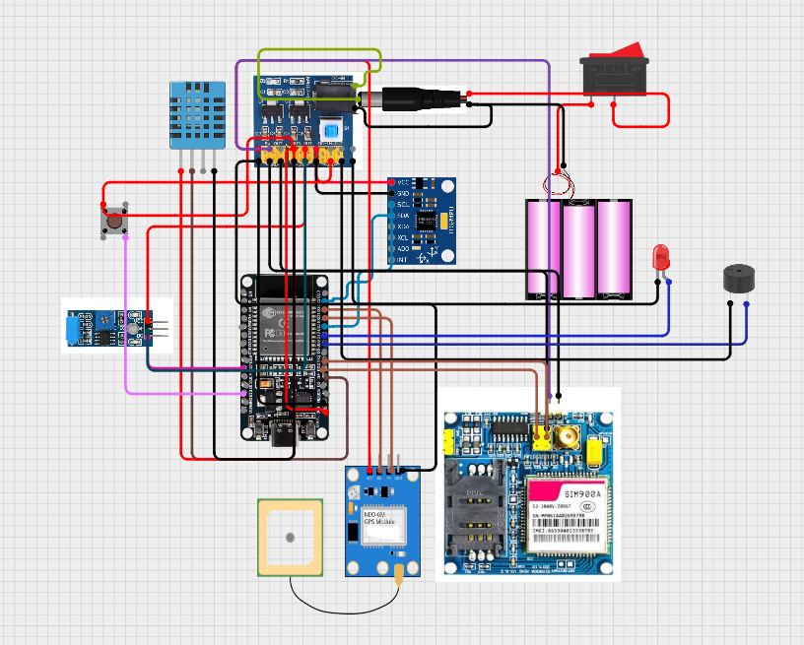
SoI Innovation Pipeline
DESIGN
Prototype System Overview — Architecture / Design
SoI Prototype Stage — Submission Deck

Slide 10
SoI Innovation Pipeline
BUILD
Prototype Build Plan & Timeline (Sprints)
Sprint / Week
Key tasks & deliverables
Owner(s)
Status
Sprint 1 / Week 1
Hardware assembly; Basic code for detection; v1 rig demo.
SHANKAR D, SHYAMJITH K
To Do
Sprint 2 / Week 2
Integrate GPS/GSM; Add severity analysis; Enclosure CAD/print; v2 tests.
TANUSHRI Y,
RATHIKA S
To Do
Sprint 3 / Week 3
Validation runs; Iterations; User guide/docs; Final demo video.
All
To Do

Slide 11
SoI Innovation Pipeline
RESOURCES
Resources, BOM & Budget
Item/resource | Qty | Unit cost | Source
ESP32 Dev Board | 1 | 400 | Majestronicz
MPU6050 | 1 | 150 | Majestronicz
SW-420 Sensor | 1 | 80 | Majestronicz
GPS Module | 1 | 300 | Majestronicz
GSM Module | 1 | 600 | Majestronicz
DHT11 | 1 | 70 | Majestronicz
Buck Converter | 1 | 130 | Majestronicz
Charging Module | 1 | 60 | Majestronicz
Item / resource

Slide 12
SoI Innovation Pipeline
RESOURCES
Resources, BOM & Budget
Li-ion Battery | 3 | 200 | Majestronicz
Buzzer | 1 | 20 | Majestronicz
LED + Resistor | 1 | 20 | Majestronicz
Push Button | 1 | 20 | Majestronicz
Jumper Wires | 1 | 100 | Majestronicz
Breadboard/PCB | 1 | 150 | Majestronicz
Battery holder | 1 | 55 | Majestronicz
DC to DC Power Module | 1 | 70 | Majestronicz
Item / resource
Unit cost
Notes

Slide 13
SoI Innovation Pipeline
VALIDATE
Prototype Demo & Validation Plan
Demo scenario (fill)
Validation protocols (fill)
Power ON the ESP32 accident alert system.
System initializes sensors, GSM, GPS, and Wi-Fi.
Normal state: no alert, buzzer and LED OFF.
Simulate accident using impact, vibration, or heat.
Buzzer and LED turn ON immediately.
If not cancelled, SMS with location is sent.
Test cases:
Impact, vibration, and temperature tests
GSM SMS delivery test
GPS location validation
Environment:
Indoor lab
Controlled testing setup
Measurements:
Detection accuracy
Alert response time
SMS delivery success
Pass / Fail:
Alert within 10 seconds
SMS sent within 3 seconds
No SMS on cancel
One SMS per event

Slide 14
SoI Innovation Pipeline
EVIDENCE
Evidence — Prototype Results & Iterations
Version
What changed
Test run
Result
Evidence link
v1
Basic sensor detection using MPU6050, SW-420, and DHT11. No filtering or validation.
10 simulated accidents (indoor, manual testing).
~80% detection accuracy. High false alerts. Slow response (~20s).
V2
Added sensor thresholds and basic vibration filtering. Improved detection logic.
15 simulated tests with varied impact levels.
~90% detection accuracy. Reduced false alerts. Response ~10–12s.
V3
Added user cancel button and alert delay timer.
20 tests including false trigger scenarios.
False alerts reduced significantly. Cancel feature works reliably.
V4 (Final)
Added sensor presence checks, pull-downs, power-failure handling, GPS location link, Wi-Fi support.
25 controlled tests (normal + emergency).
Stable operation. No ghost readings. SMS sent only once per event.

Slide 15
SoI Innovation Pipeline
LINKS
Prototype Demo & Artifacts
Links (paste)
Demo video file upload (MP4, ≤2 min)
https://drive.google.com/drive/folders/1Lw_Jyrlj0b0D-FHmPm_PgBvxmHGrVJ_S?usp=sharing
Repository URL
https://github.com/Tanushri050106/Smart_accident_alert_system.git
Build files (CAD/PCB)
https://drive.google.com/file/d/1kxooSEyvCVsXnTP8Jz5kNs5qIstxdNFy/view?usp=sharing
Dataset / logs
Vibration, temperature and accelorometer sensors dataset, emergency trigger test logs
Release / version
V4 (Final)

Slide 16
SoI Innovation Pipeline
RISK
Risks, Limitations & Mitigations
Risk / limitation
Impact (L/M/H)
Likelihood
Mitigation / next action
GSM signal failure in remote areas
H
M
Add retry logic; Test in varied locations; Next: Offline buffering.
False positives from road bumps
M
M
Refine thresholds with ML; More calibration data; Next: Field tests.
Power drain in idle mode
M
L
Optimize code/sleep modes; Next: Dedicated battery IC.
Data privacy (location sharing)
H
L
Use encrypted SMS; Dummy data only; Next: GDPR compliance check.
Hardware damage in tests
L
M
Use protective casing; Spare parts; Next: Robust materials.

Slide 17
SoI Innovation Pipeline
DECISION
Go / Refine / Pivot & Next Steps → MVP
Decision
Next steps toward MVP
Achieved ≥95% detection and ≤15s latency in v2 tests.
Low false positives (1%) after iterations.
Usability feedback positive; Risks mitigated for core function
1. Integrate cloud backend for multi-device monitoring.
2. Conduct small pilot with 5 real vehicles (controlled).
3. Secure insurance partnerships for data validation.
KPIs to carry forward:
Detection accuracy ≥98%; Response time 80%; Cost per unit <₹2000.
Decision: [GO / REFINE & RE-TEST / PIVOT]
Rationale (tie to metrics):

Slide 18
SoI Innovation Pipeline
REFS
References
[1] MAT Journals, “IoT-Based Accident Detection System,” 2023. URL: [matjournals.com] (accessed 2026-01-20). [2] rsepress.org, “Vehicle Accident Detection Using Sensors,” 2022. URL: [rsepress.org] (accessed 2026-01-20). [3] Elementary Education, “Accelerometer-Based Crash Alert,” 2021. URL: [elementaryeducation.com] (accessed 2026-01-20).
[4] Irjaeh, “Sensor Tech for Emergency Alerts,” 2023. URL: [irjaeh.com] (accessed 2026-01-20).
[5] UTHM Publisher, “ESP32 GPS GSM Accident Detection,” 2024. URL: [uthm.edu.my] (accessed 2026-01-20).

